Slide 1







MOVIES GUIDE APP

Slide 2


Team Members
Martina Samy
Nada Hamdy
Ahmed Osama
Mohamed Ashraf
Menna Mohamed

Slide 3

INTRODUCTION

Slide 4

Movies Guide App is a centralized platform that simplifies movie discovery by allowing users to search movies, watch trailers—all in one place. With a clean interface and fast performance, it offers a seamless and convenient experience for movie enthusiasts.

Slide 5
FEATURES

Slide 6

Features
Search movies
View movie info (release date, runtime, director)
Movie trailer
Movie rating
Add to favorite
Showing similar movies

Slide 7
USER FLOW

Slide 8
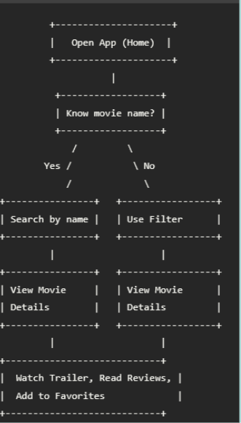

Slide 9
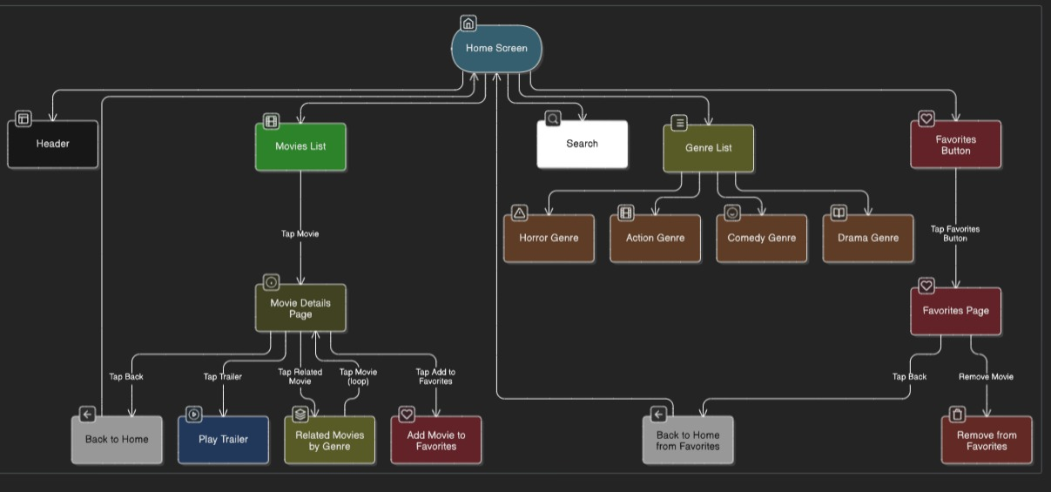

Slide 10
USE CASES

Slide 11
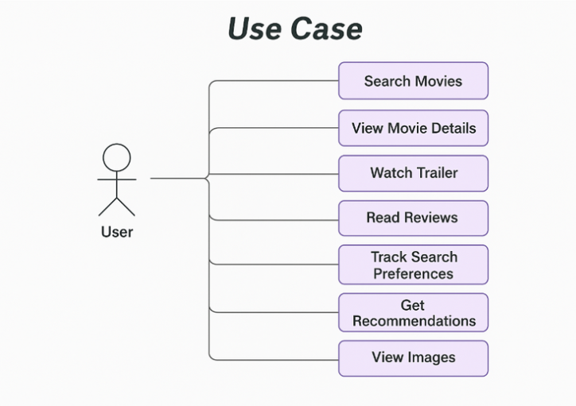



Slide 12
ENTITY RELATIONSHIP DIAGRAM (ERD)

Slide 13
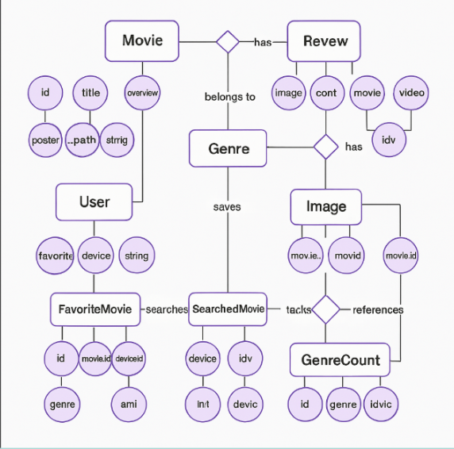

Slide 14
SCREENSHOTS
(USER INTERFACE)

Slide 15
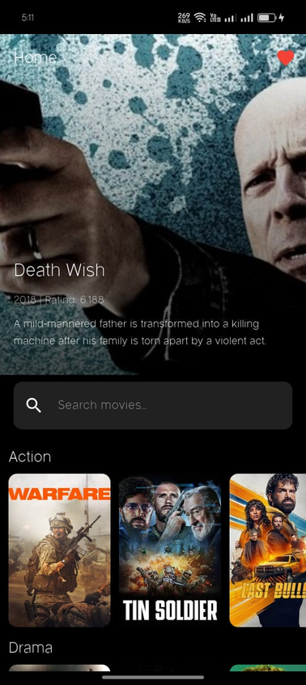
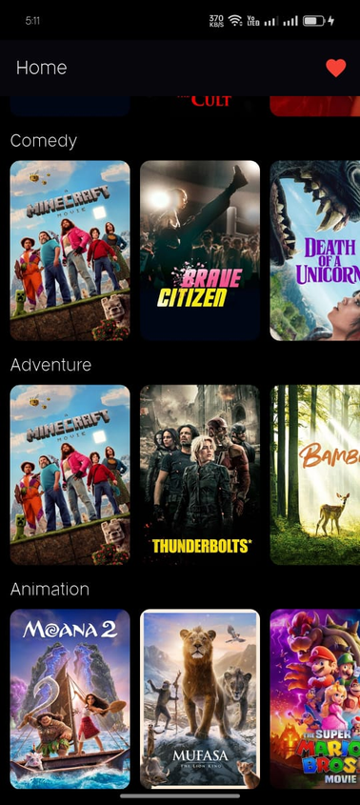
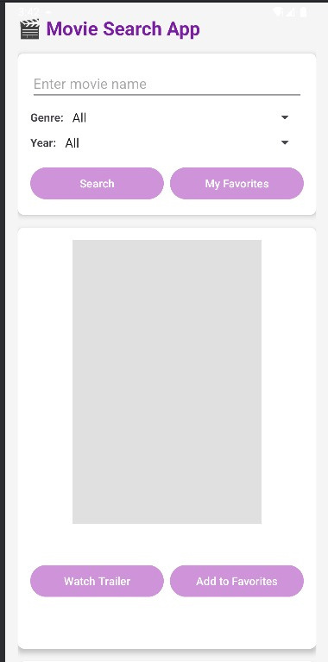
Home Page

Slide 16
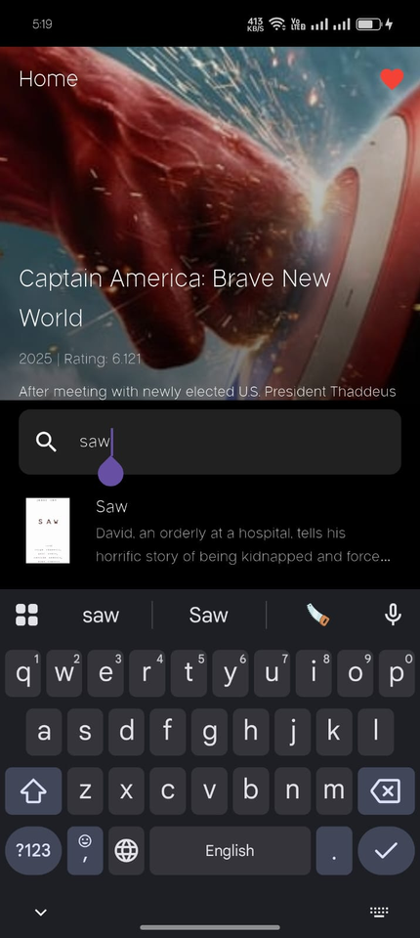
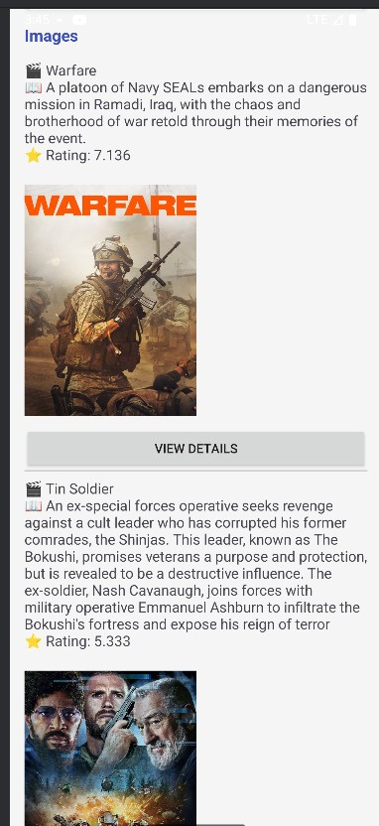
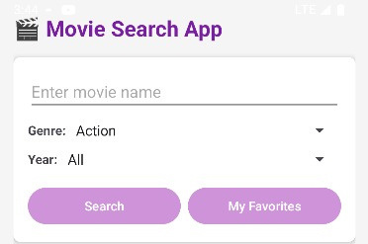
Search Bar

Slide 17
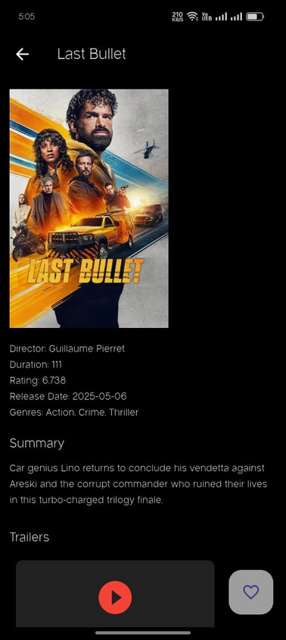
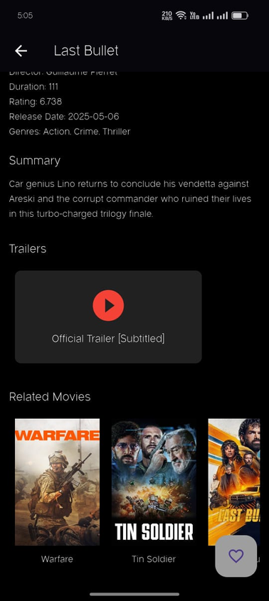
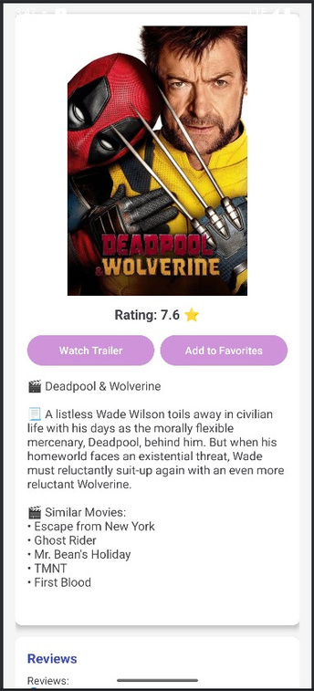
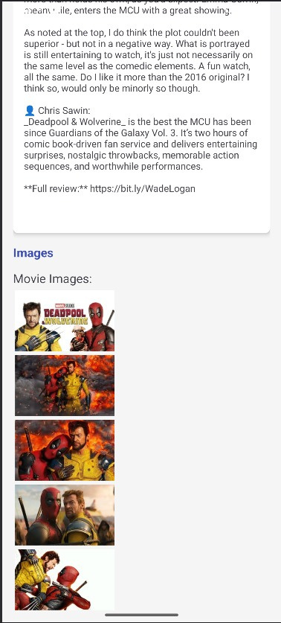
Movie Details

Slide 18
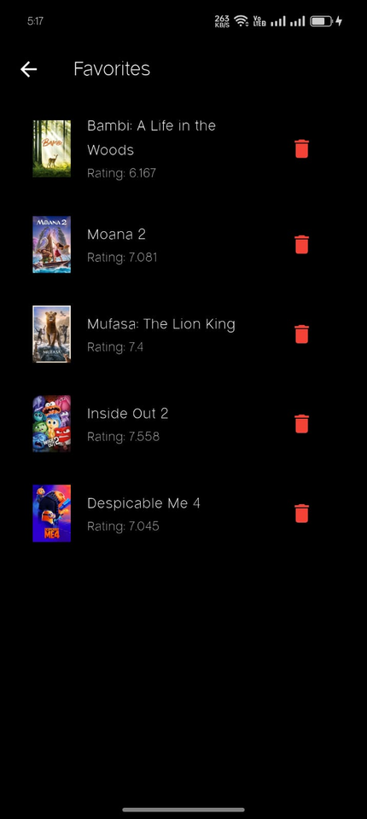

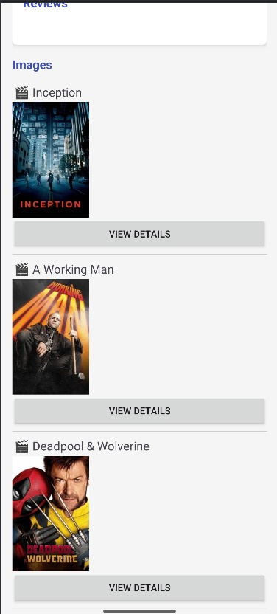
Favorite Page

Slide 19
BUSINESS FEASIBILITY

Slide 20
Why This App?
Solves a real user pain point by combining all features in one place.
Clean, intuitive UI for casual users.

Slide 21
TECHNICAL FEASIBILITY

Slide 22
Performance:
API Fast calls, Optimized image loading.
Architecture:
Clean code architecture (divided into more than one page)
UI/UX:
Modern design
Easy navigation

Slide 23
THANK YOU!

